Slide 1
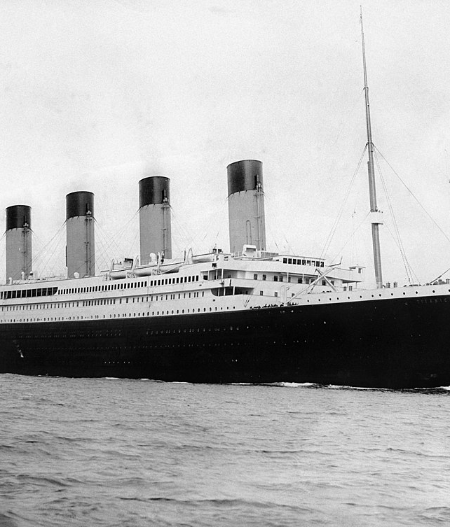
Titanic Survival Prediction Exploratory Data Analysis & Machine Learning
27 July 2025

Slide 2

Dataset Overview
891 passengers, 12 features
Categorical: Sex, Embarked, Cabin, Ticket, Name
Numerical: Pclass, Age, SibSp, ParCh, Fare
Target: Survived (0 = no, 1 = yes)
[1] [2] [3]

Slide 3
Preprocessing Pipeline
Load & Inspect Data
Combine Train & Test
Encode Categories
Impute Ages
Clean & Drop Columns
Feature Eng.
Key operations: • Unified imputation of missing ages using KNN • Label encoding of Sex & Embarked categories • Dropping low-signal columns (Cabin, Name, Ticket) • Engineering FamilySize and IsAlone features
[4] [5] [6] [7]

Slide 4
Model Training & Evaluation
Algorithms evaluated: • Logistic Regression • K-Nearest Neighbours • Support Vector Machine • Random Forest • XGBoost (tuned)
Hyperparameter tuning performed for XGBoost via grid search.
Best Model:
Tuned XGBoost achieved the highest validation accuracy

Slide 5
Key Insights
Women, children and the upper class were far more likely to survive
Female passengers: 74% survival vs. males: 19%
1st class travellers enjoyed the highest survival odds
[8] [9] [10] [11]

Slide 6
Conclusion & Next Steps
Data preprocessing matters: Proper imputation, encoding and feature engineering improved model performance Model selection: Among several classifiers, tuned XGBoost delivered the best validation accuracy Domain insights: Survival odds were highest for females, children and 1st class passengers; small families fared better than solitary or large groups Future work: Explore additional features (e.g., titles), perform cross‑validation and expand hyperparameter tuning for further improvement
[1] [8]

